Slide 1
Loading and Rendering a Textured Pyramid
Advanced Game Engine Creation

Slide 2
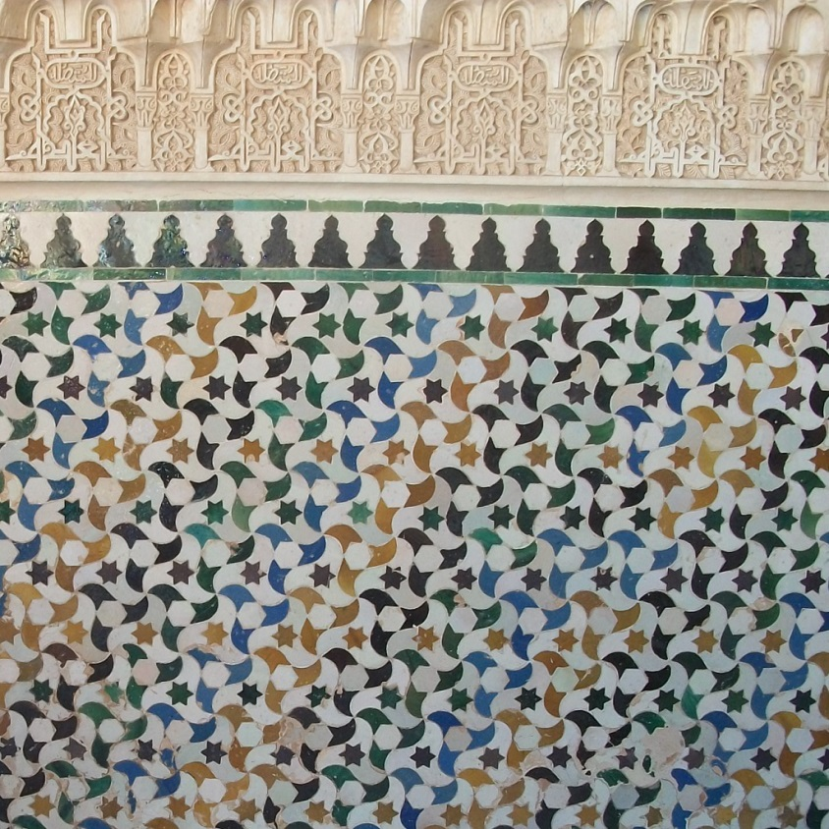
Using a texture
add the (u,v) coordinates corresponding to each vertex to the bottom of the data file
5
0.5 0.5
0 0
1 0
1 1
0 1
and provide a texture

Slide 3
Storing the texture map
we learned how to load and enable the texture itself last week
we can still do this in GameScreenLevel1
or move the code to the Pyramid class
need to add a new struct to Commons.h:
struct TexCoord {
float u;
float v;
};
and add a new member variable to the Pyramid class
TexCoord * texCoords;

Slide 4
Loading the texture map
inFile >> numVertices;
if (numVertices > 0) {
texCoords = new TexCoord[numVertices];
for (int i = 0; i < numVertices; i++)
{
inFile >> texCoords[i].u;
inFile >> texCoords[i].v;
}
}

Slide 5
Drawing with a texture
void Pyramid::DrawTriangle(short a, short b, short c) {
glBegin(GL_TRIANGLES);
glTexCoord2f(texCoords[a].u, texCoords[a].v);
glNormal3f(normals[a].x, normals[a].y, normals[a].z);
glVertex3f(indexedVertices[a].x, indexedVertices[a].y, indexedVertices[a].z);
// and so on for indices b and c

Slide 6
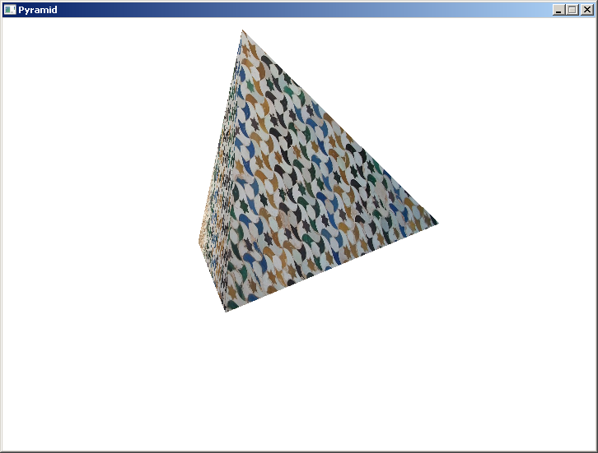
A textured pyramid

